Slide 1

Exploratory Data Analysis on IPL
Submitted By Anoop Painuly
PGP-June’20 Batch

Slide 2


Table of Contents
Problem Statement
Data Collection
Pre-profiling & Pre-processing
Match Winners
Batting Performance
Bowling Performance
Fielding Performance
Conclusion or Summarization
Actionable Insights

Slide 3
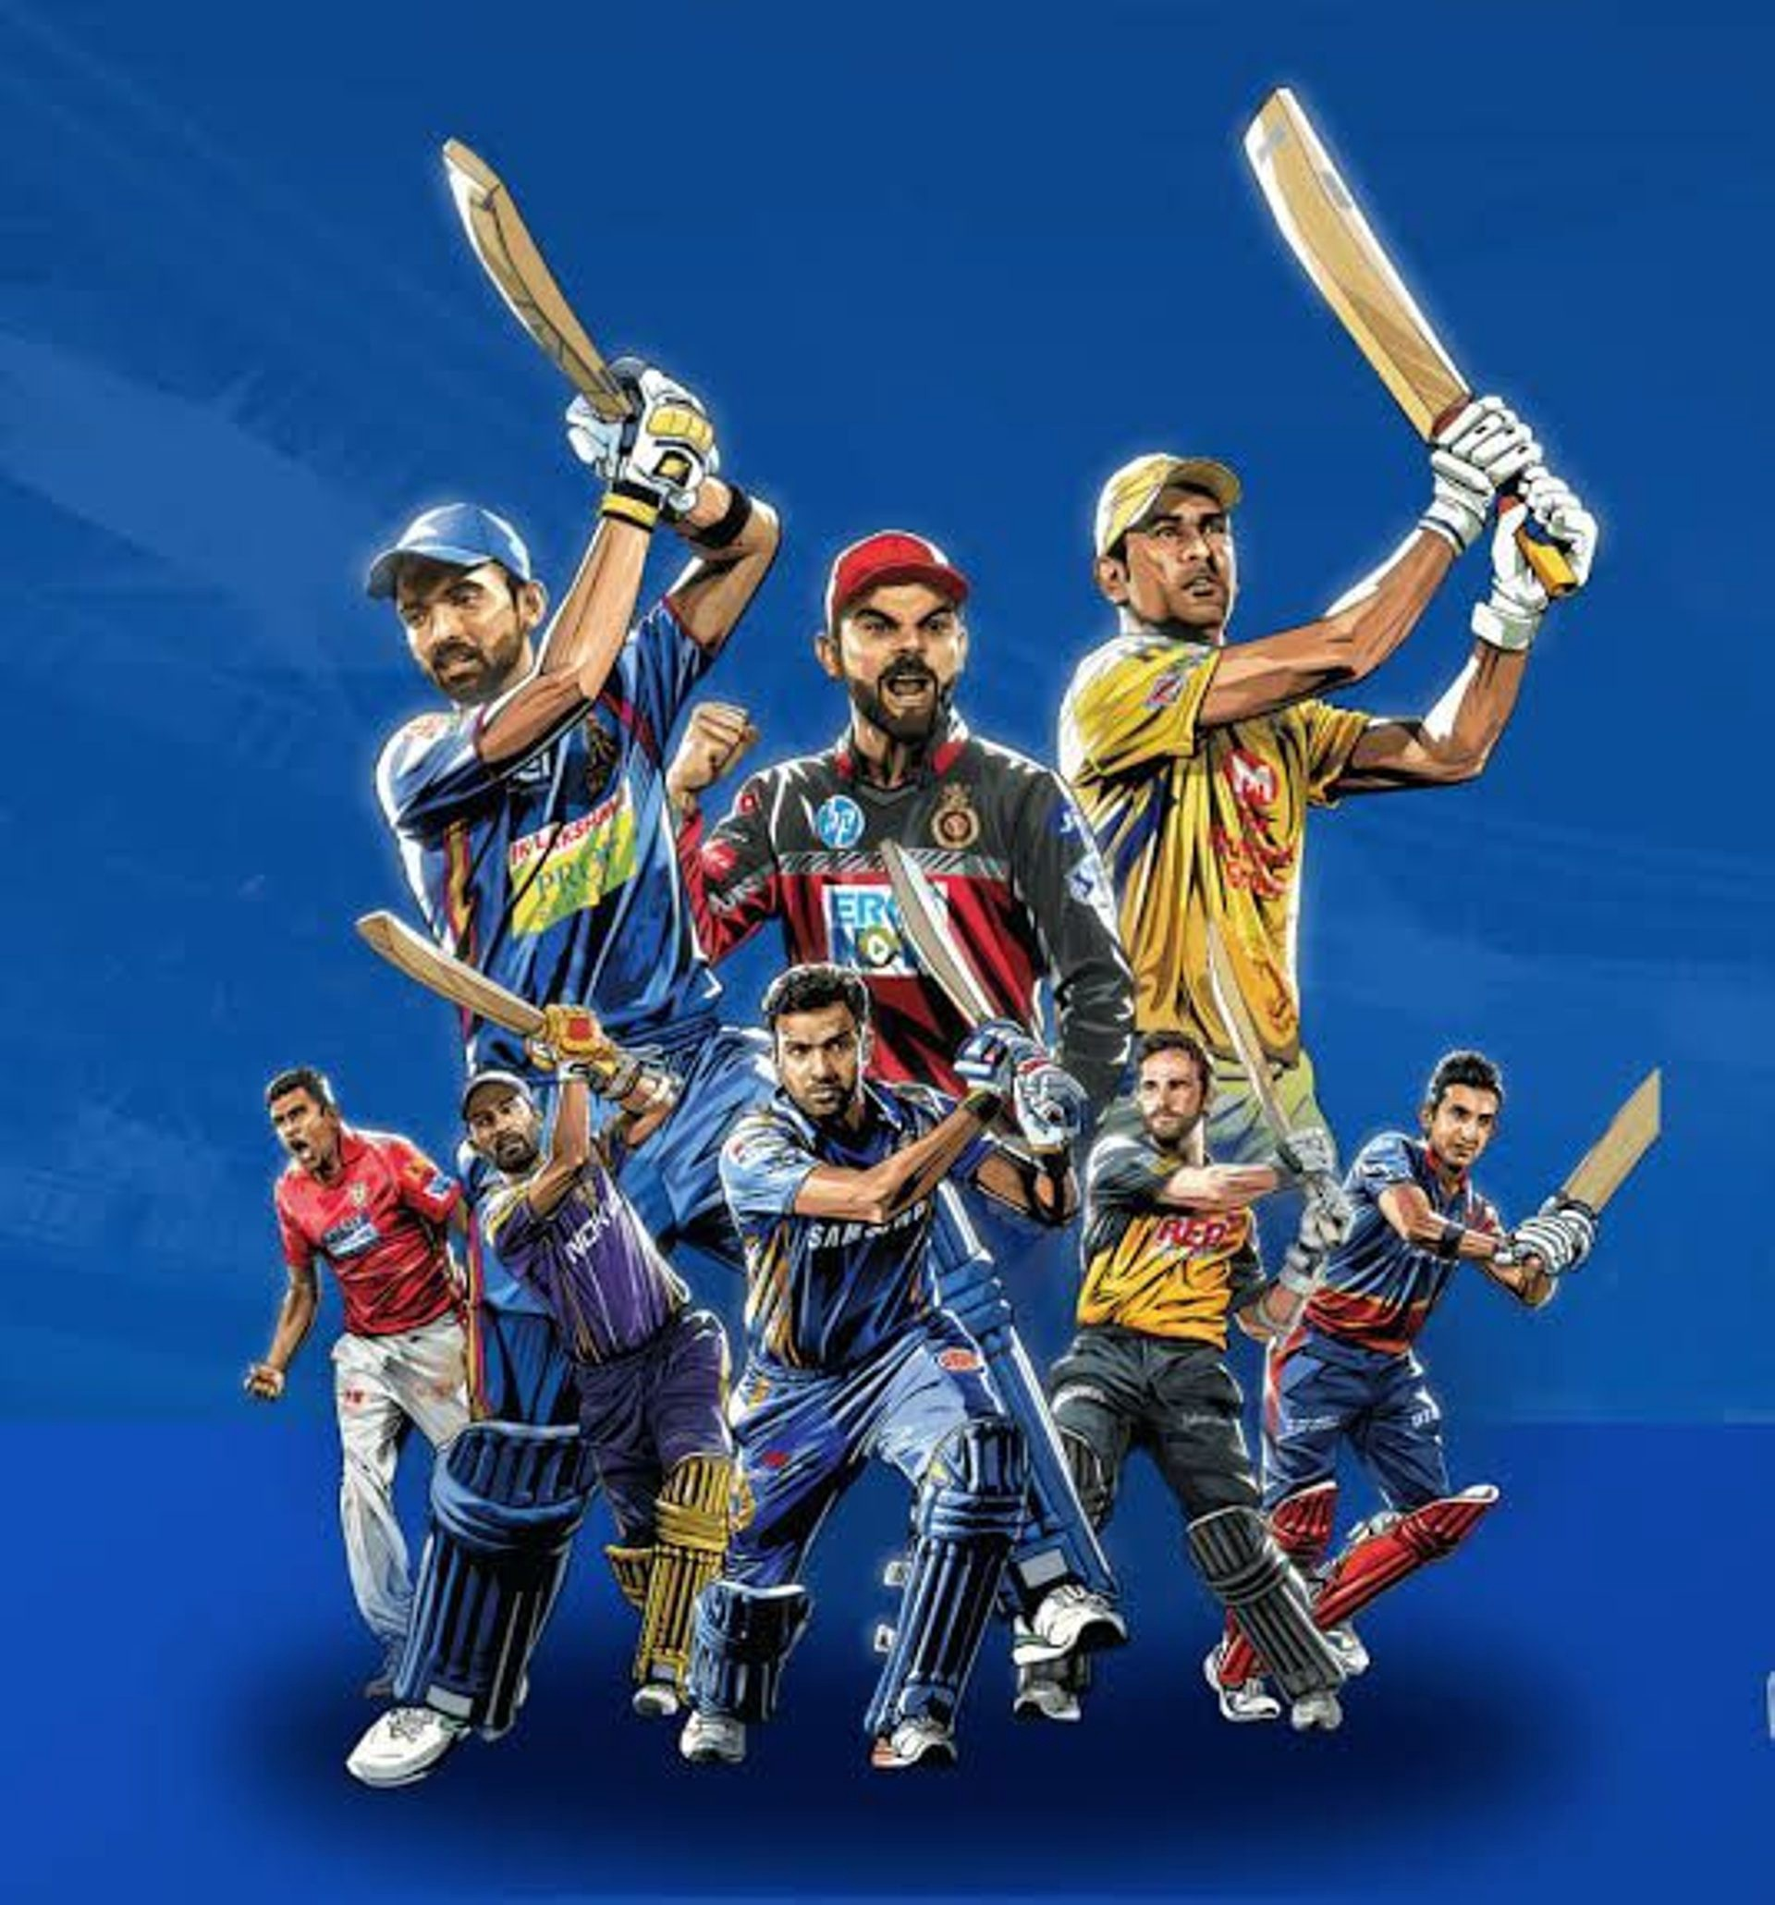
Problem Statement
The Indian Premier League (IPL) is a professional Twenty20 cricket league in India contested every year by eight teams representing eight different cities in India.
By analyzing the players on different aspects like Batting, Bowling and Fielding, let us try to find the value they add to their teams and thus the role they play in winning the tournament.

Slide 4

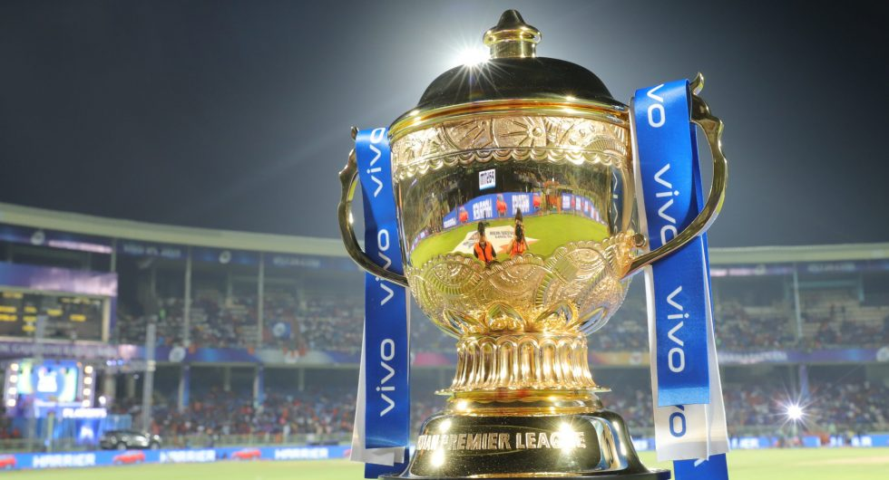
Data Collection
Match Details dataset: Matches played in every season from 2008 to 2018 in the IPL(Indian Premiere League).
Source: https://raw.githubusercontent.com/insaid2018/Term-1/master/Data/Projects/matches.csv
Delivery Details dataset: Delivery Level Detail(ball by ball) for every season from 2008 to 2018 in the IPL(Indian Premiere League)
Source: https://raw.githubusercontent.com/insaid2018/Term-1/master/Data/Projects/deliveries.csv

Slide 5
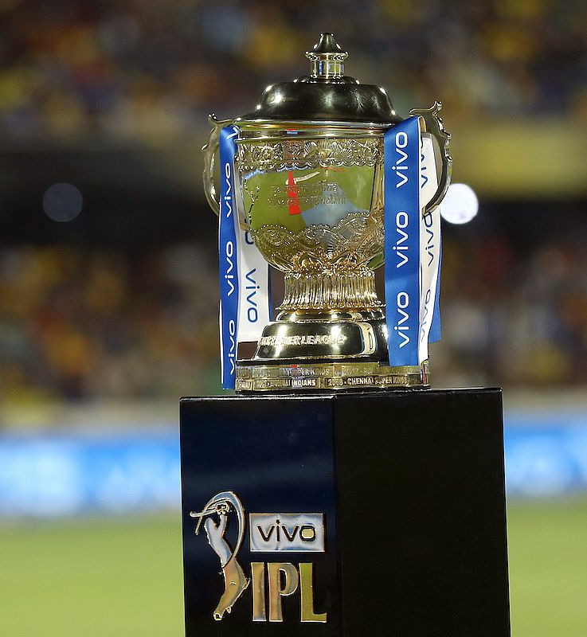
Pre-Profiling & Pre-processing
Joining the 2 Datasets to form a consolidated dataset
Drop redundant columns like 'date', 'umpire1', 'umpire2', 'umpire3 etc.
Observations & Actions:
Missing Values in the ‘City’
All the missing city column has 'Dubai International Cricket Stadium' as venue
Replace those city values by ‘Dubai’

Slide 6
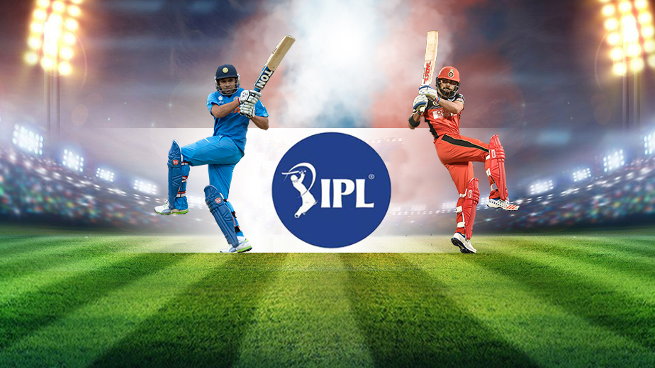
Player Performance Analysis

Slide 7


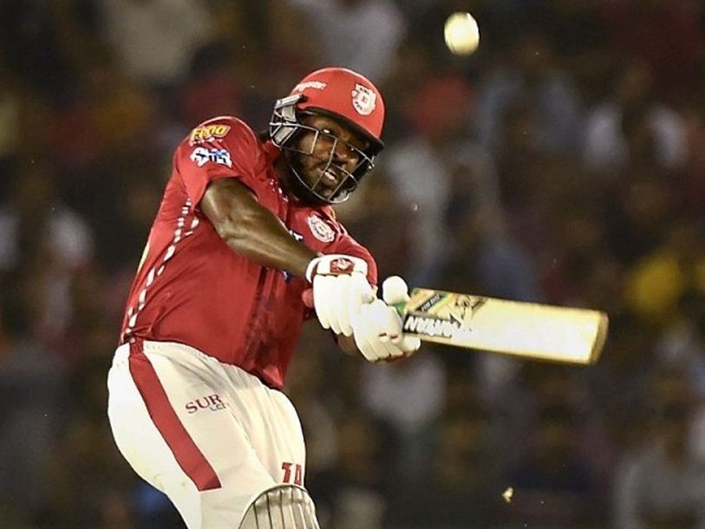
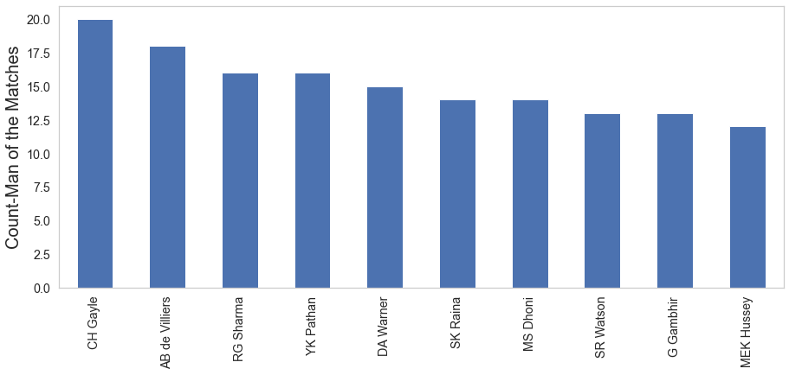
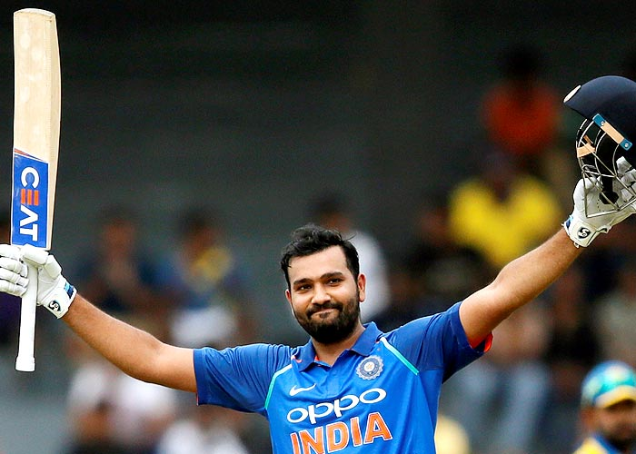
Match Winner: Which Player received highest Player of Match awards?
Man of the Match award is given to the outstanding player, who makes the most impact, in a particular match

Slide 8
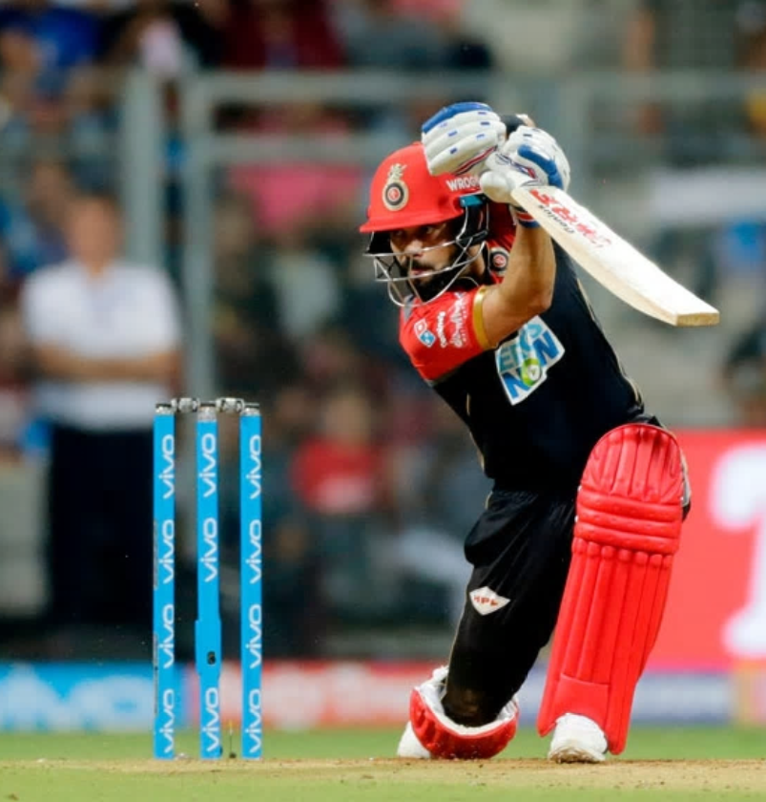
Batting performance
While identifying the batting effectiveness of a player, we need to analyze the below 3 parameters:
Run scored by the batman
Batting Average
Strike Rate

Slide 9
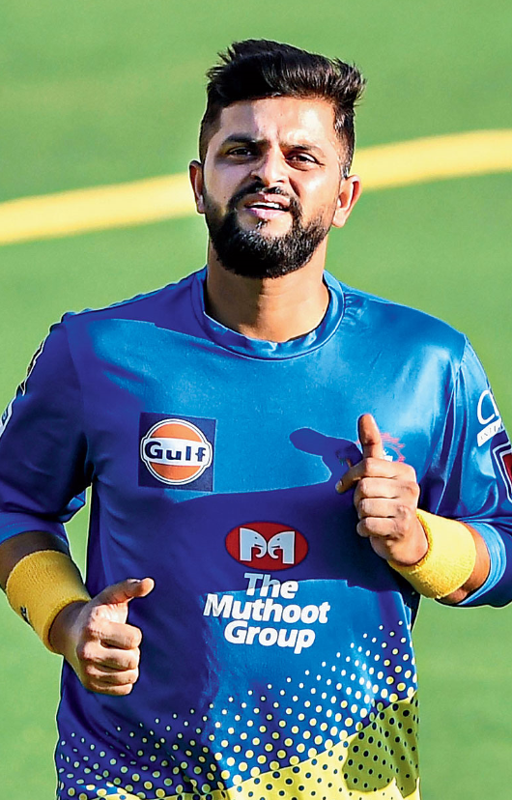
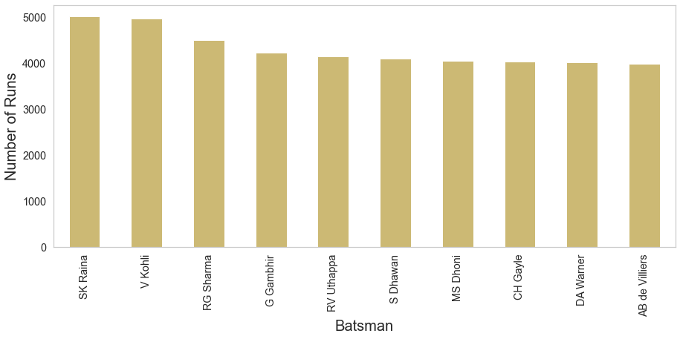
Who is the highest run getter?

Slide 10
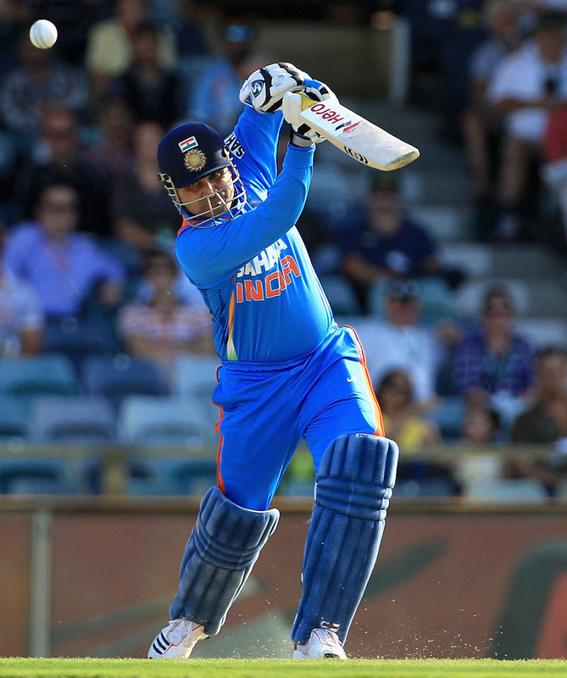
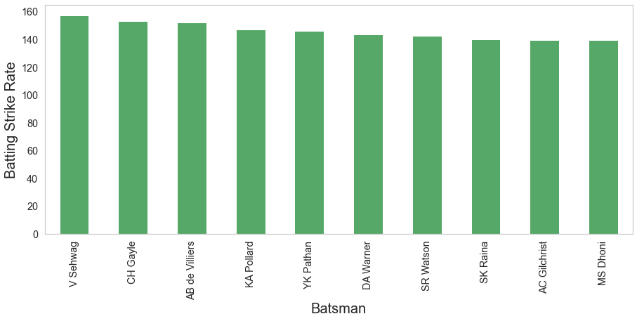
Which batsman has the best strike rate?
Exclusions:
For calculating the number of balls faced by the batsman we have excluded all the wide balls faced by the batsman
Strike Rate: Average number of runs scored per 100 balls faced.
Threshold: #Batsmen with 2000+ runs in IPL

Slide 11
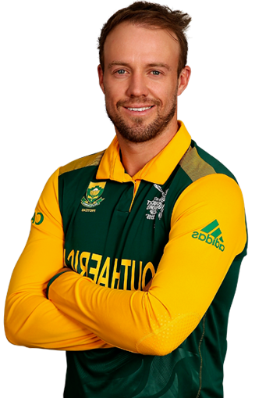
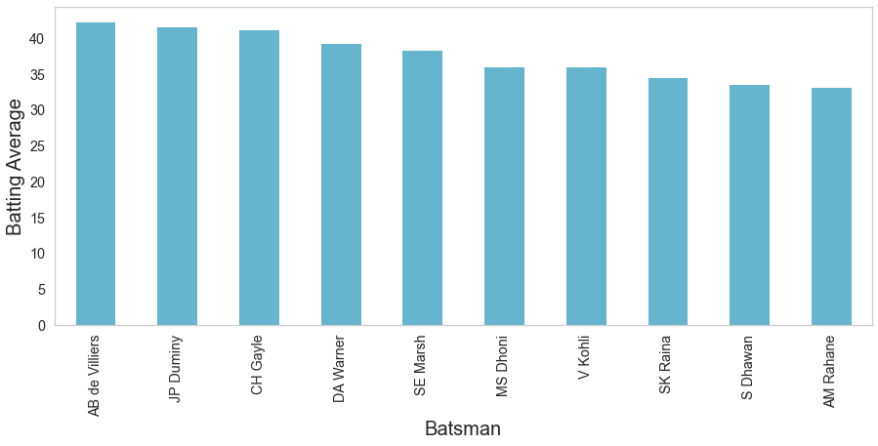
Which batsman has the best batting average?
Total number of runs scored divided by the number of times out.
Threshold: Batsmen with 2000+ runs in IPL

Slide 12
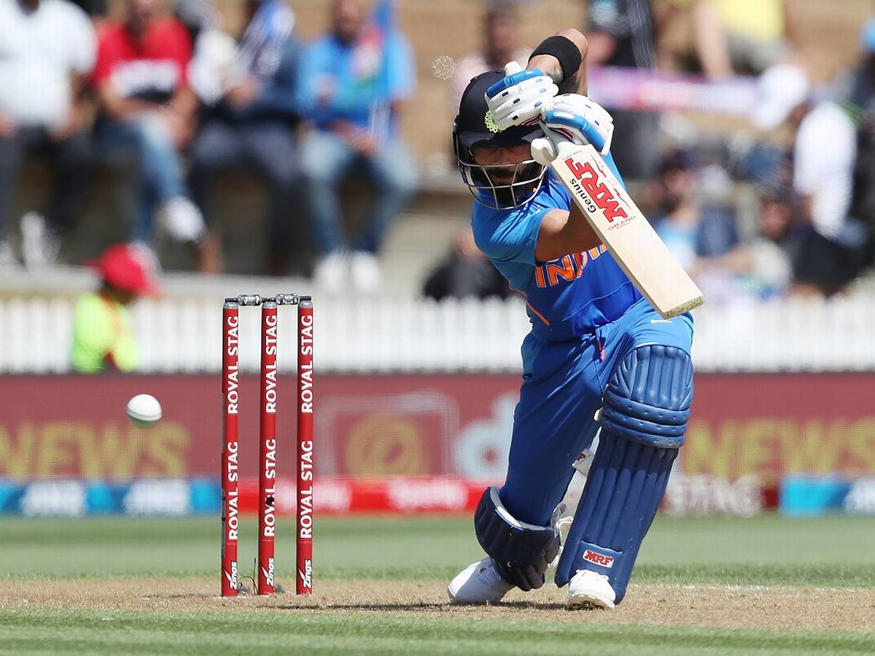
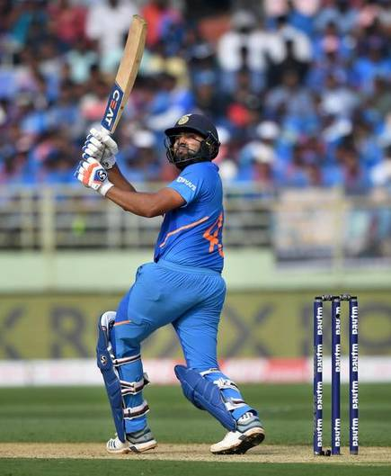
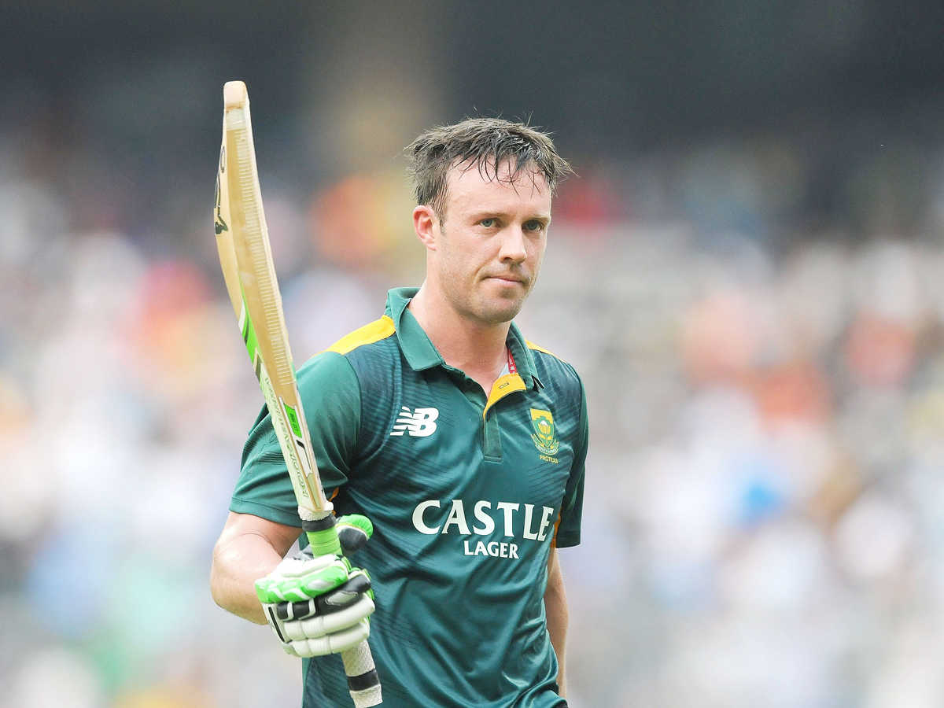
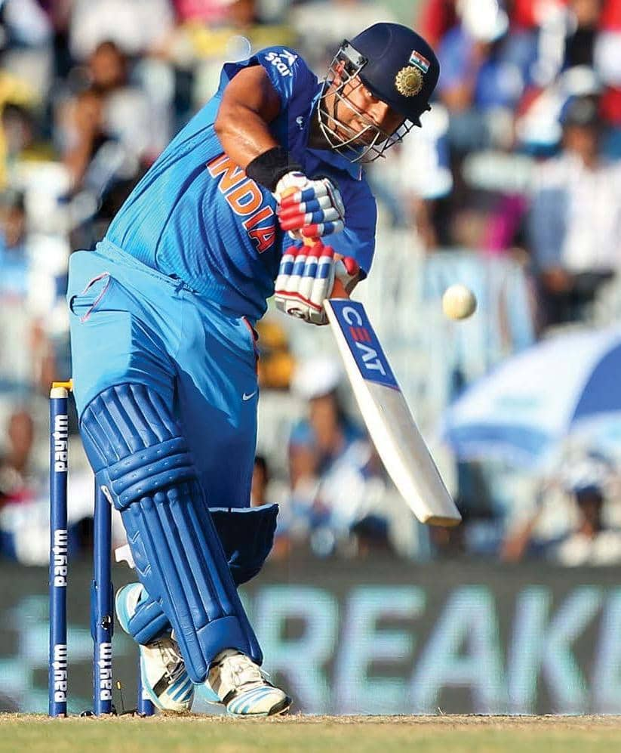
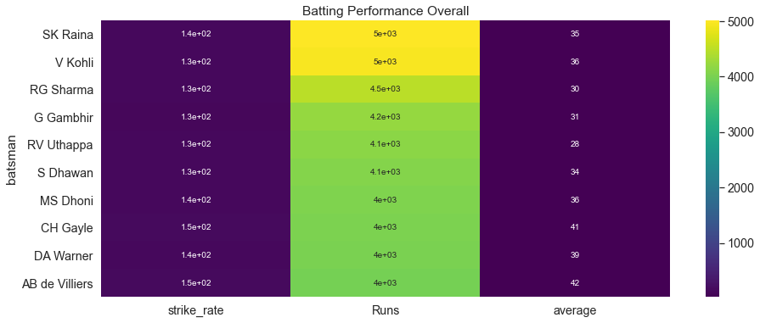
Overall Batting Performance Comparison

Slide 13
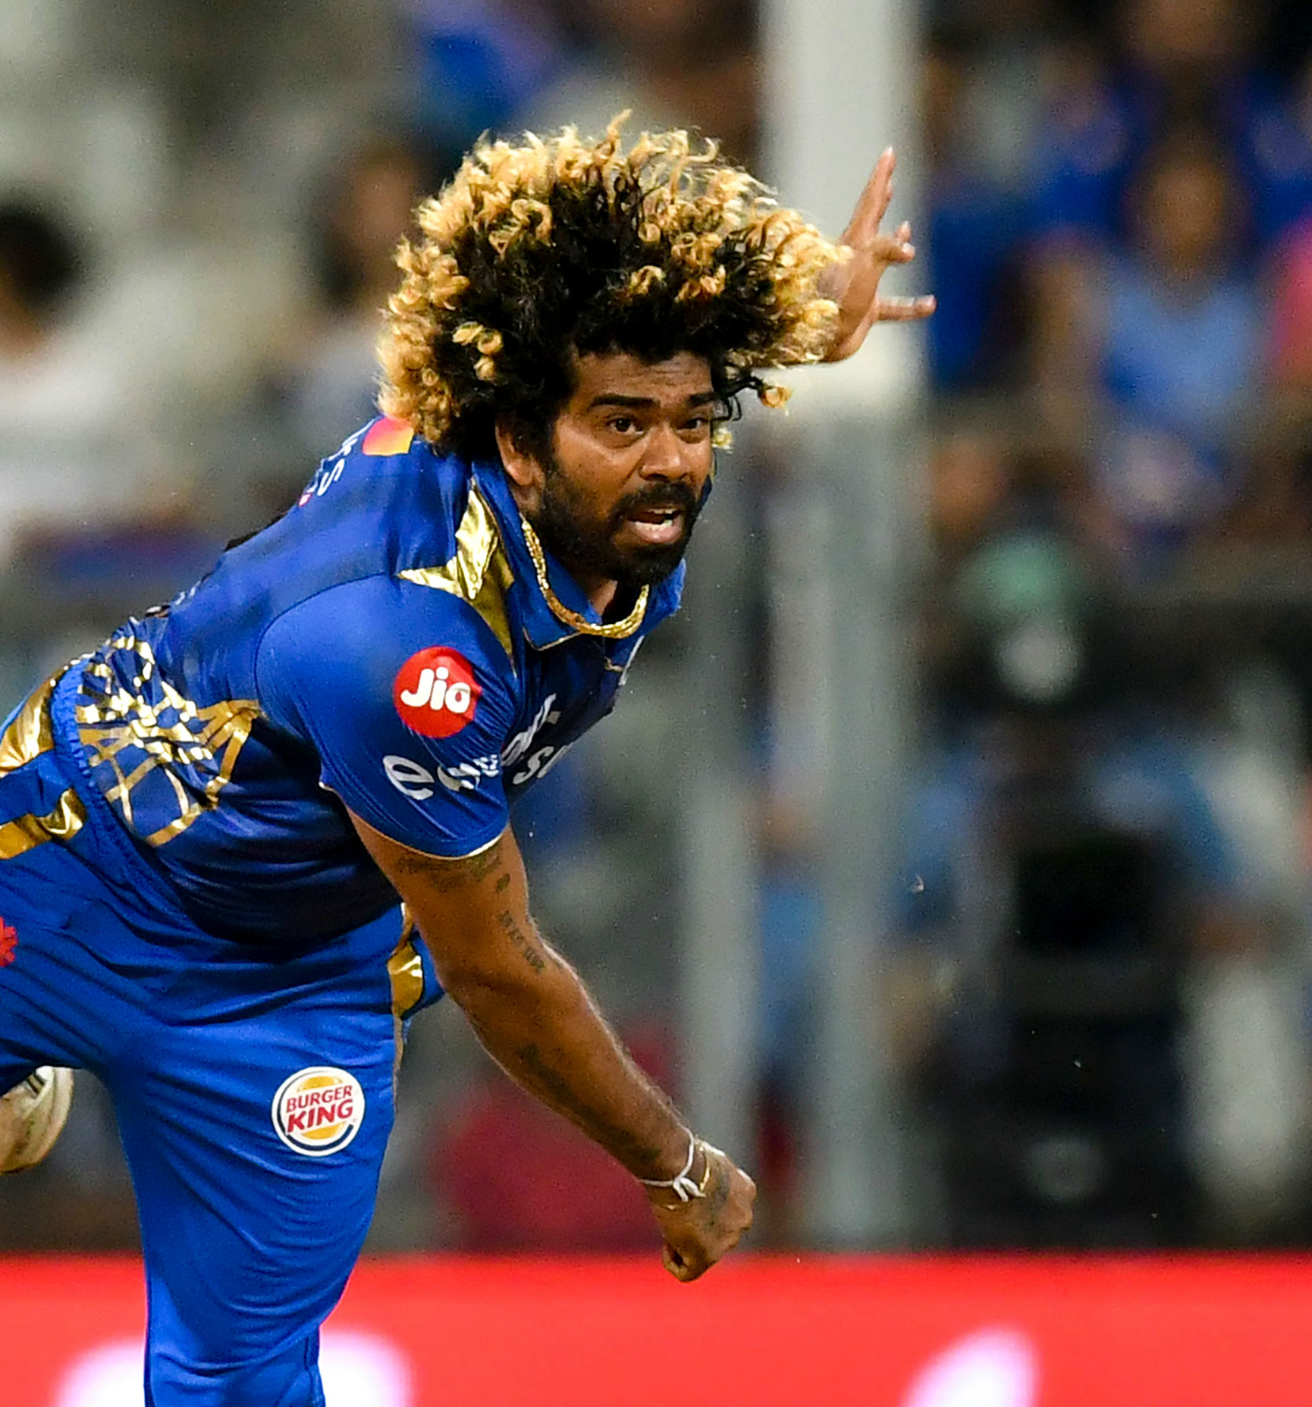
Bowling Performance
While identifying the bowling performance, we need to analyze the below 4 parameters:
Wicket taken by a bowler
Bowling Average
Bowling Strike Rate
Economy Rate

Slide 14
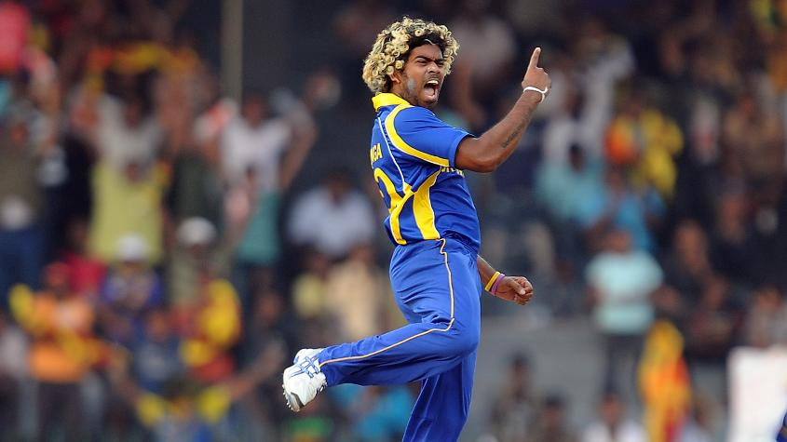
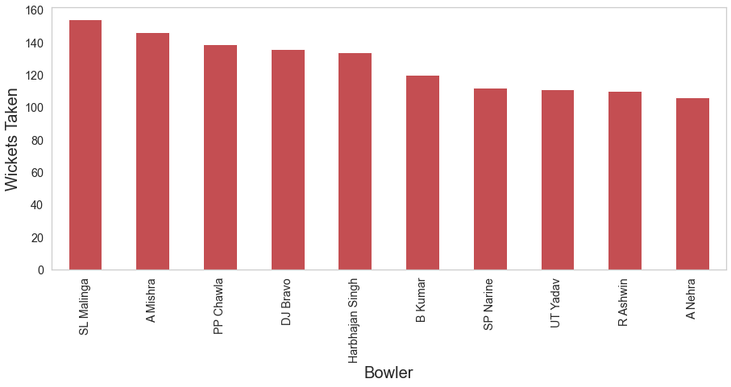
Who is the highest wicket taker?
Exclusions: 'run out', 'retired hurt', 'obstructing the field’
Inclusions: 'caught', 'bowled', 'lbw', 'caught and bowled’, 'stumped'

Slide 15
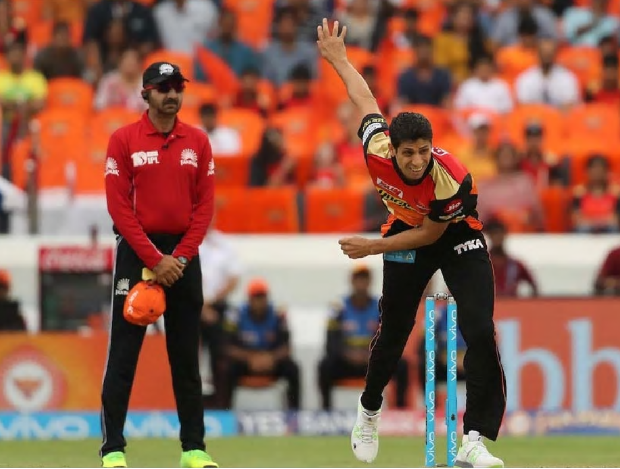
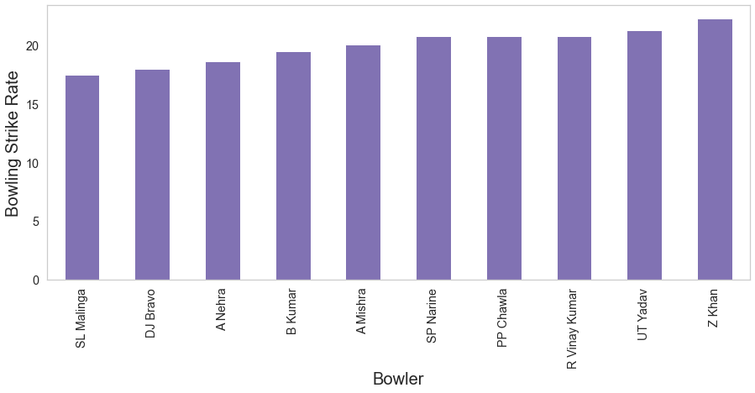
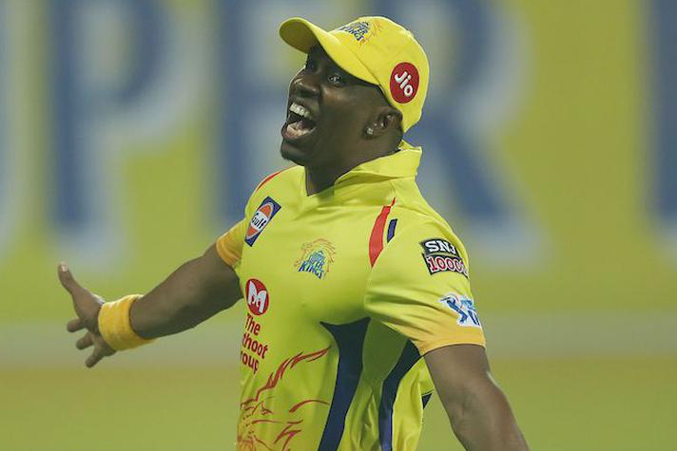
Which bowler has the best strike rate?
Threshold: 100+ wickets in IPL
Strike Rate: Average number of balls bowled per wicket taken. The lower the strike rate, the more effective a bowler is at taking wickets quickly.

Slide 16
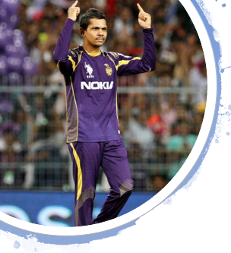
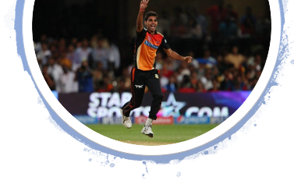
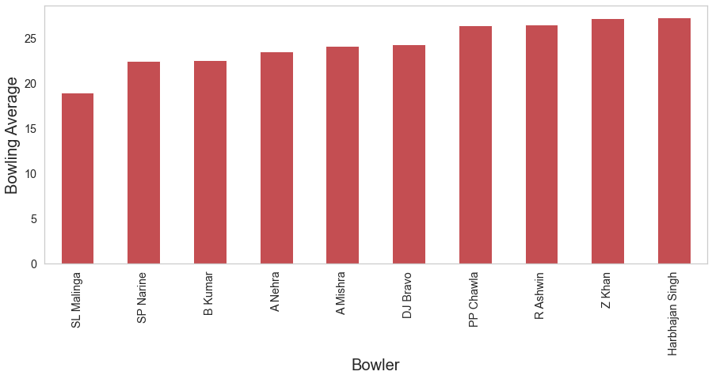
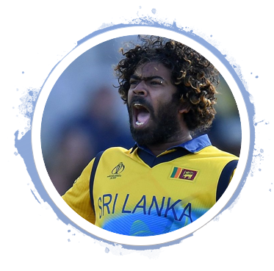
Which bowler has the best bowling average?
Exclusions:
Leg byes and byes are excluded from runs conceded by the bowler
Exclusions:
Leg byes and byes are excluded from runs conceded by the bowler
Bowling Average: Number of runs conceded per wicket taken
Threshold: 100+ wickets in IPL
Threshold: 100+ wickets in IPL

Slide 17
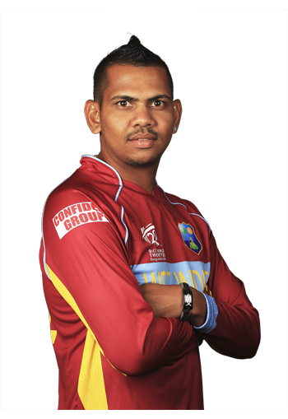
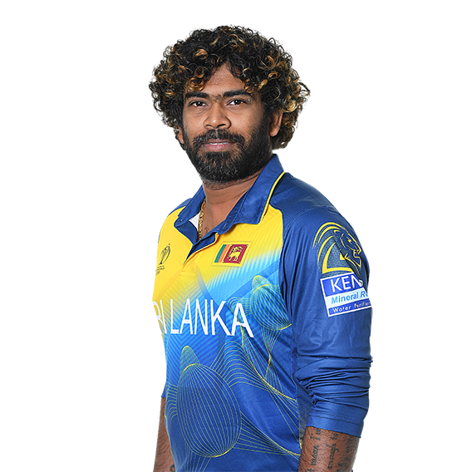
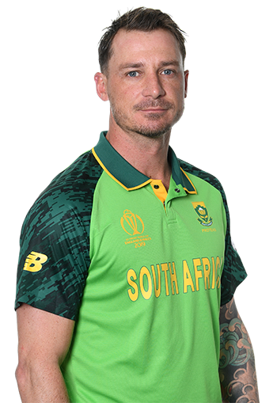
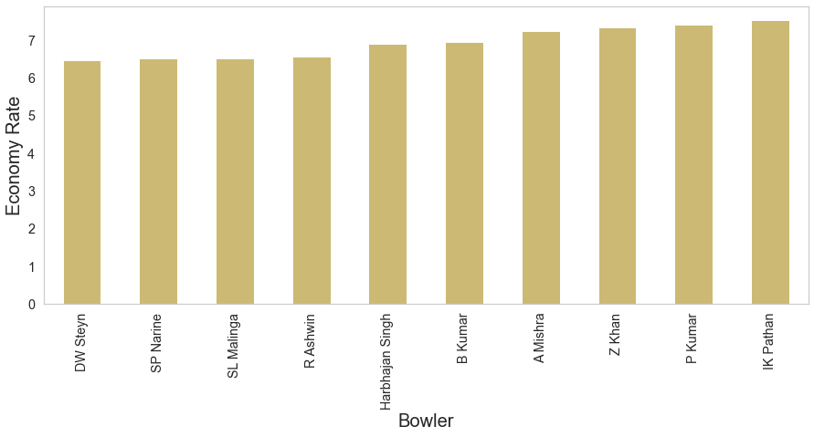
Which bowler has the best economy rate?
Economy rate: Number of runs a bowler concedes per over bowled.
Exclusions:
Leg byes and byes are excluded from runs conceded by the bowler
Threshold: 100+ wickets in IPL

Slide 18
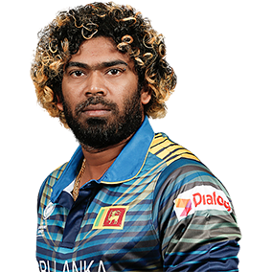
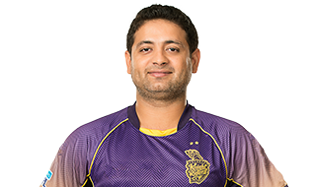
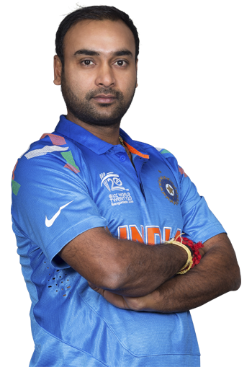
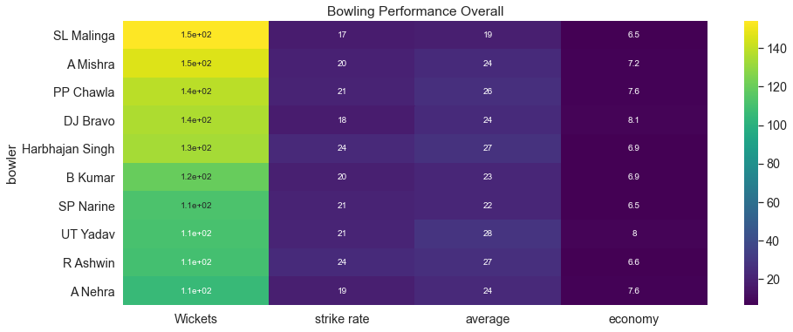
Overall Bowling Performance Comparison

Slide 19
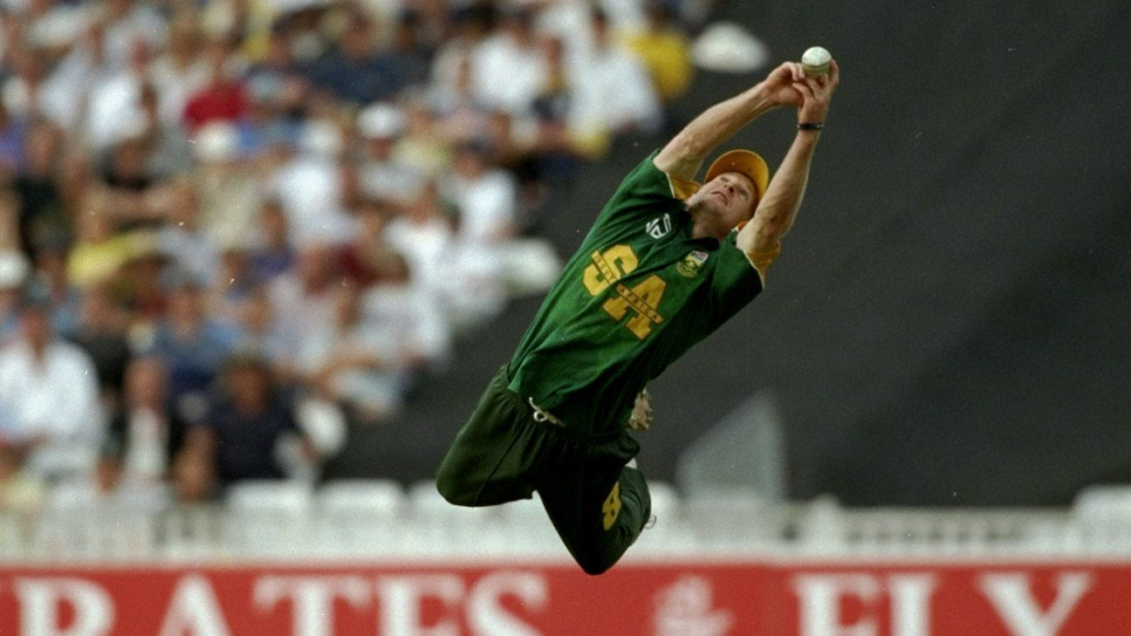
Fielding Performance
We have analyzed the fielding performance of a player by the number of catches taken

Slide 20
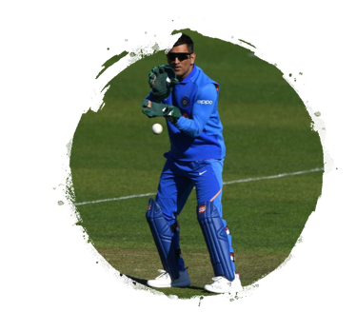
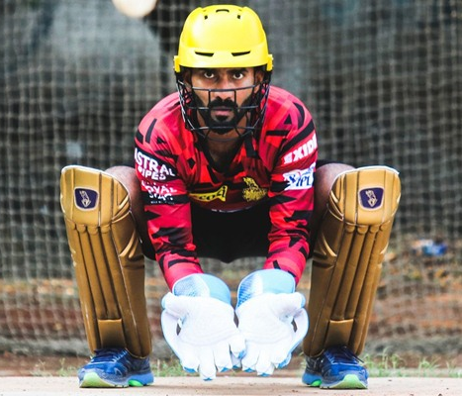
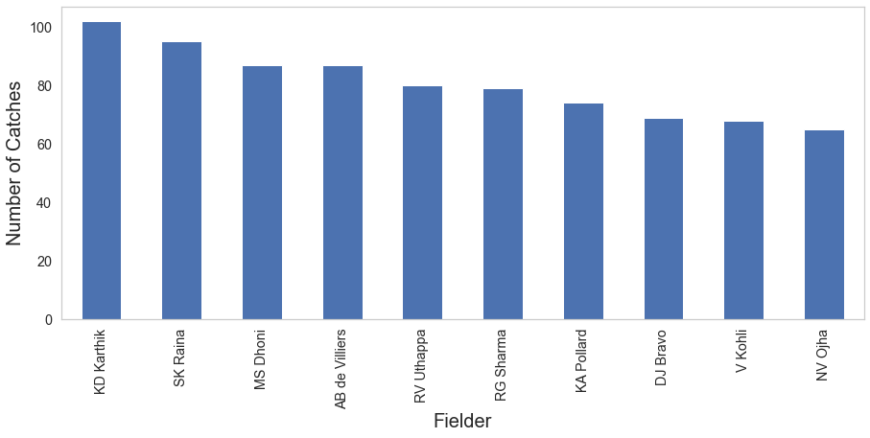
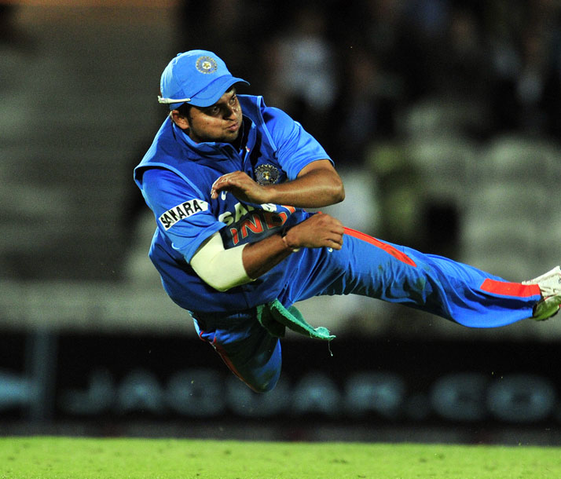
Which fielder has the taken the maximum number of catches?
Inclusion: 'caught and bowled’ cases are counted as catches under bowler’s name

Slide 21
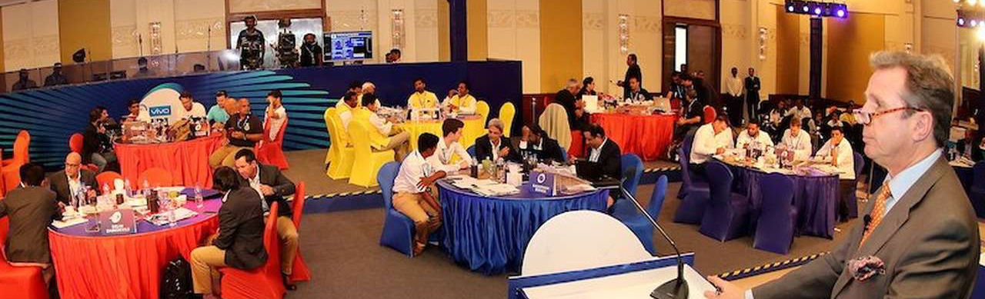
Conclusion or Summarization
It is analyzed that the when it comes to most match winning performances then Chris Gayle tops the chart as he has received the Man of the Match Award maximum number of times, followed by AB.de Villiers and Rohit Sharma. This simply means that when it comes to winning the matches these players make the maximum impact and are most sought-after players in the bidding process
In the department of batting, overall best performers have been Suresh Raina, Virat Kohli and Rohit Sharma as their overall batting stats(runs, average, and strike rate) are balanced and at the top as well.
In the department of bowling, SL Malinga stands ahead from all other bowlers as his stats speak for his overall performance in the IPL. He is the leading wicket taker, along with the best strike rate and average. In the economy front also he is at overall no 3. The other bowlers who have also been very impactful in the IPL are Amit Mishra and PP Chawla.
Top catcher of the IPL has been KD Karthik, followed by SK Raina, so they also play an important role in their team's success in the IPL.

Slide 22
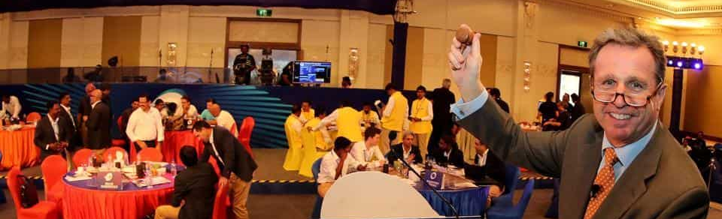
Actionable Insights
Franchise must make sure that they manage to get Chris Gayle, Virat Kohli and Rohit Sharma if they need to increase their winning chances.
To strengthen the batting of the team Suresh Raina, Virat Kohli and Rohit Sharma must be included in the teams. Suresh Raina and Rohit Sharma belong to Chennai SuperKings and Mumbai Indians Respectively who are 2 top teams in IPL so far.
To strengthen the bowling of the team SL Malinga should definitely be considered. No Doubt why Mumbai Indians is the team with maximum no of titles under their name.

Slide 23

Thank You

